Slide 1
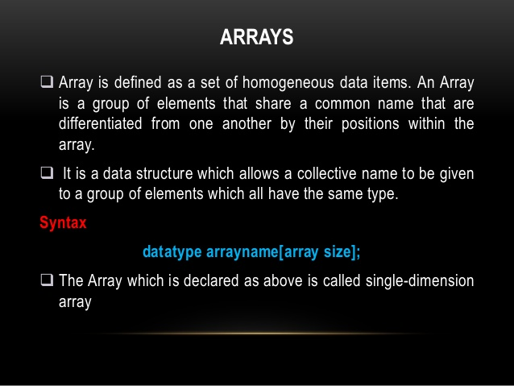

Slide 2
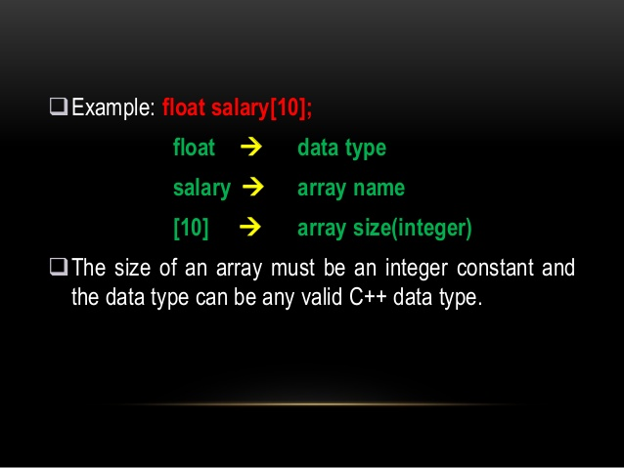

Slide 3
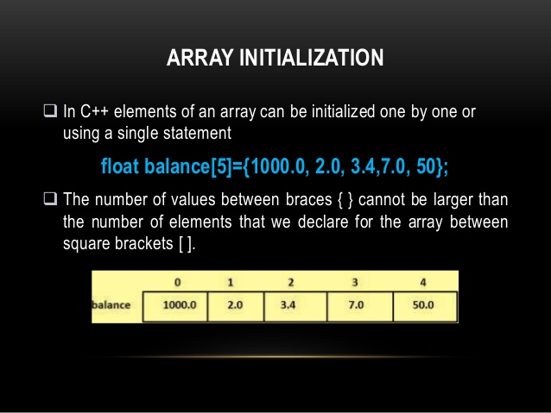

Slide 4
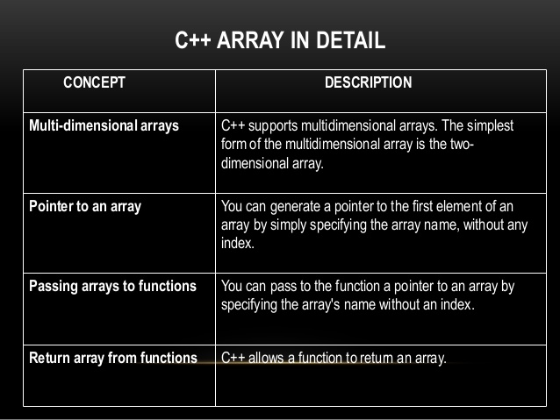

Slide 5
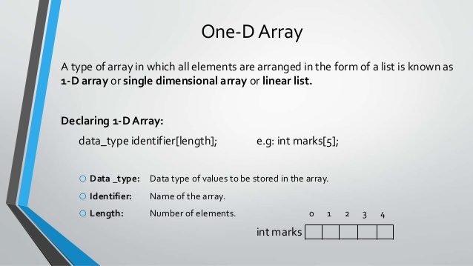

Slide 6
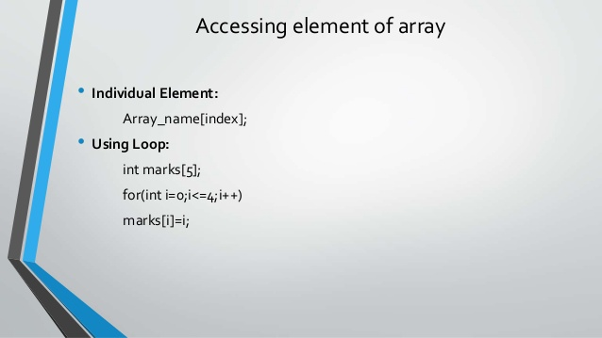

Slide 7
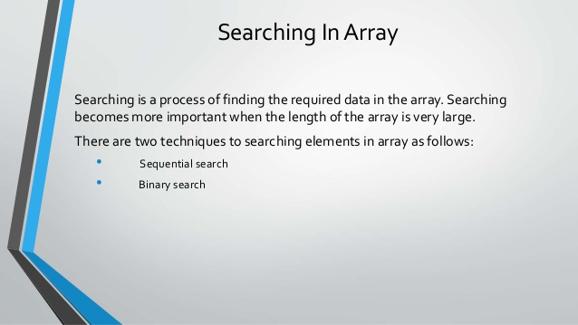

Slide 8
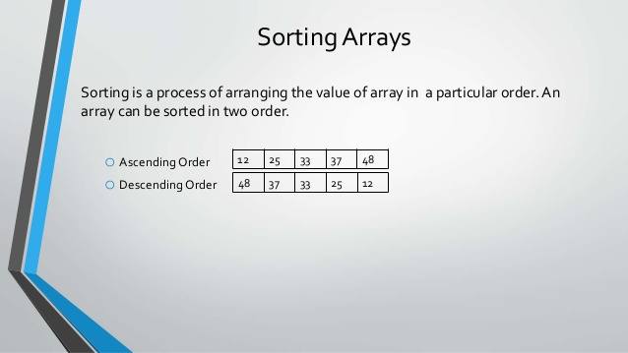

Slide 9
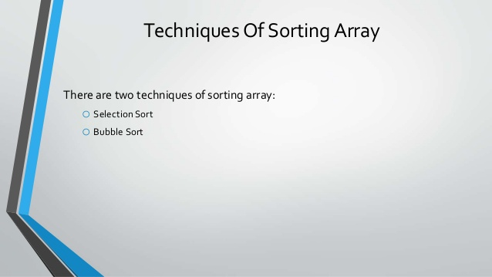

Slide 10
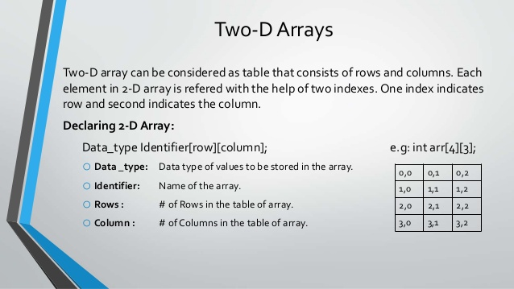

Slide 11
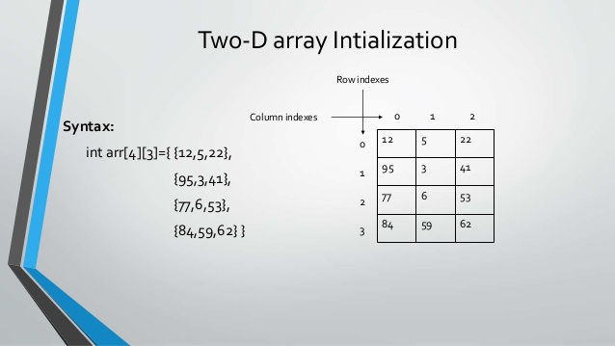

Slide 12
One-d array
Int marks[10];
For(int i=0;i<10;i++)
{
cout<<“enter marks of students”;
cin>>marks[i];
}

Slide 13
#include <iostream>
using namespace std;
int main()
{
int numbers[5];
cout << "Enter 5 numbers: " << endl; // store input from user to array
for (int i = 0; i < 5; ++i)
{
cin >> numbers[i];
}
cout << "The numbers are: "; // print array elements
for (int n = 0; n < 5; ++n)
{
cout << numbers[n] << " ";
}
return 0;
}

Slide 14
Output
Enter 5 numbers:
11
12
13
14
15
The numbers are: 11 12 13 14 15

Slide 15
Example 3: Display Sum and Average of Array Elements Using for Loop
#include <iostream>
using namespace std;
int main()
{
// initialize an array without specifying size
double numbers[] = {7, 5, 6, 12, 35, 27};
double sum = 0;
double count = 0;
double average;
cout << "The numbers are: ";
// print array elements // use of range-based for loop
for (const double &n : numbers)
{
cout << n << " ";
// calculate the sum
sum += n;
// count the no. of array elements
++count;
}
// print the sum
cout << "\nTheir Sum = " << sum << endl;

Slide 16
Output
The numbers are:
7
5
6
12
35
27 Their Sum = 92
Their Average = 15.3333

Slide 17
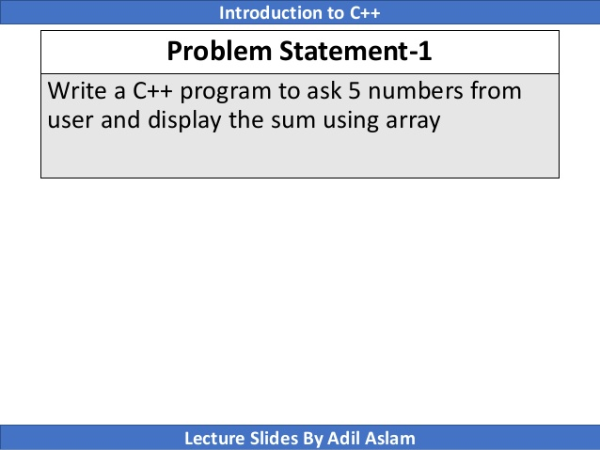

Slide 18
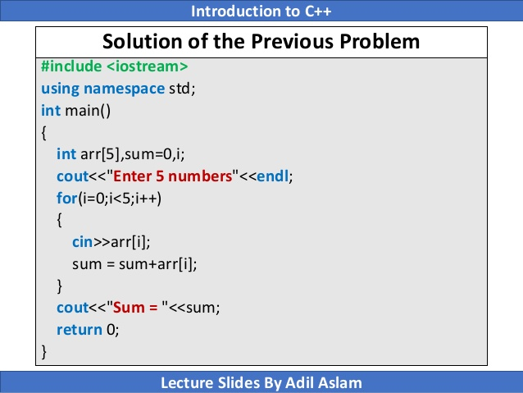

Slide 19
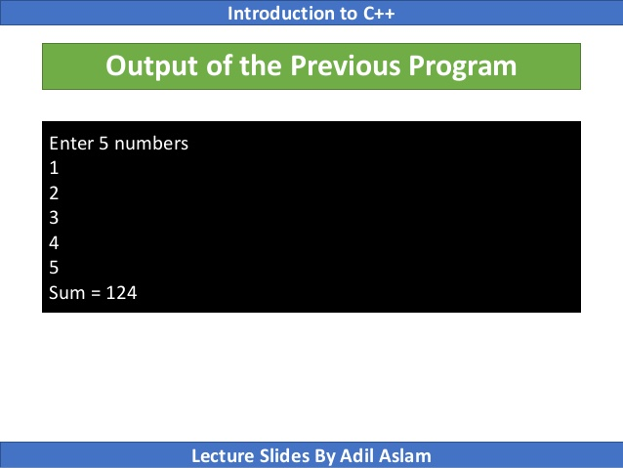

Slide 20
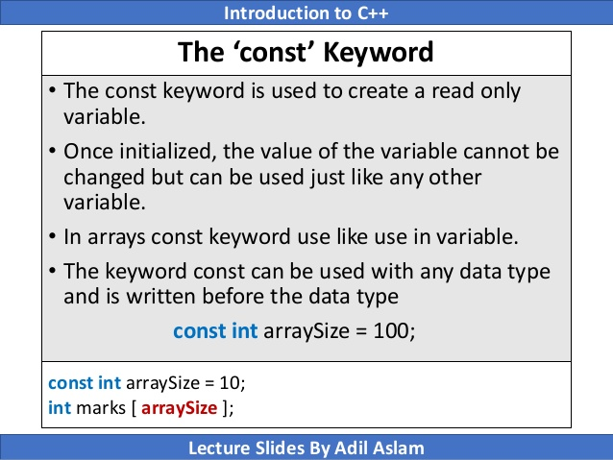

Slide 21
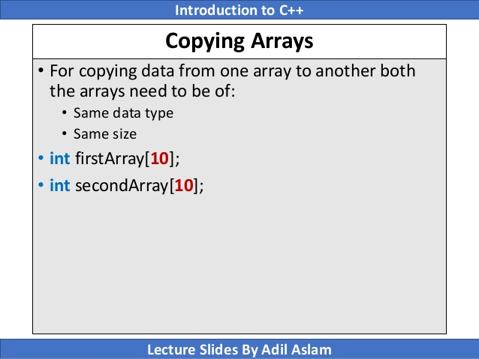

Slide 22
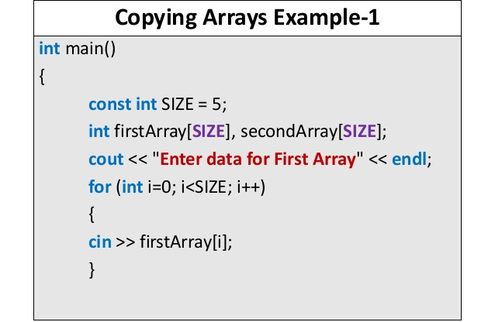

Slide 23
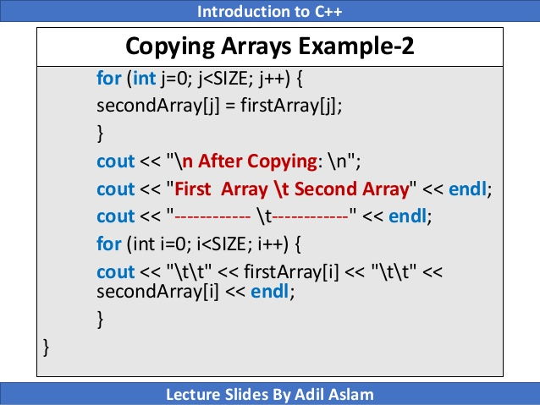

Slide 24
